Slide 1
Logistic Regression
Anshu Pandey

Slide 2
What is Logistic Regression?
Logistic Regression is a classification algorithm that models the probability of the output class.
It estimates relationship between a dependent variable (target/label) and one or more independent variable (predictors) where dependent variable is categorical.

Slide 3
Logistic Regression Features
Expects a "smooth" linear relationship with predictors.
Logistic Regression is concerned with probability of a discrete outcome.
Slightly less prone to over-fitting
Because fits a shape, might work better when less data available.

Slide 4
Assumptions
* Binary logistic regression requires the dependent variable to be binary. * For a binary regression, the factor level 1 of the dependent variable should represent the desired outcome. * Only the meaningful variables should be included. * The independent variables should be independent of each other. That is, the model should have little or no multicollinearity. * The independent variables are linearly related to the log odds. * Logistic regression requires quite large sample sizes.

Slide 5
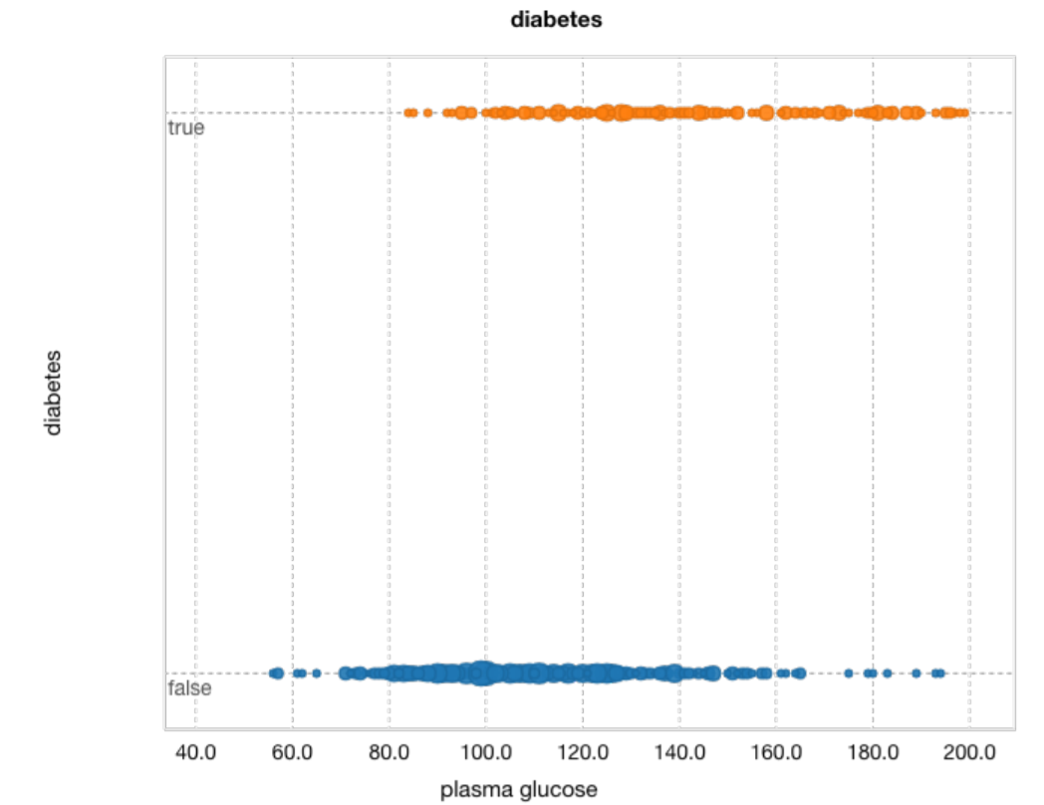
Logistic Regression – Diabetes Dataset
Y axis
True: Perosn has diabetes
Flase: No diabetes
X Axis
Feature – plasma glucose

Slide 6
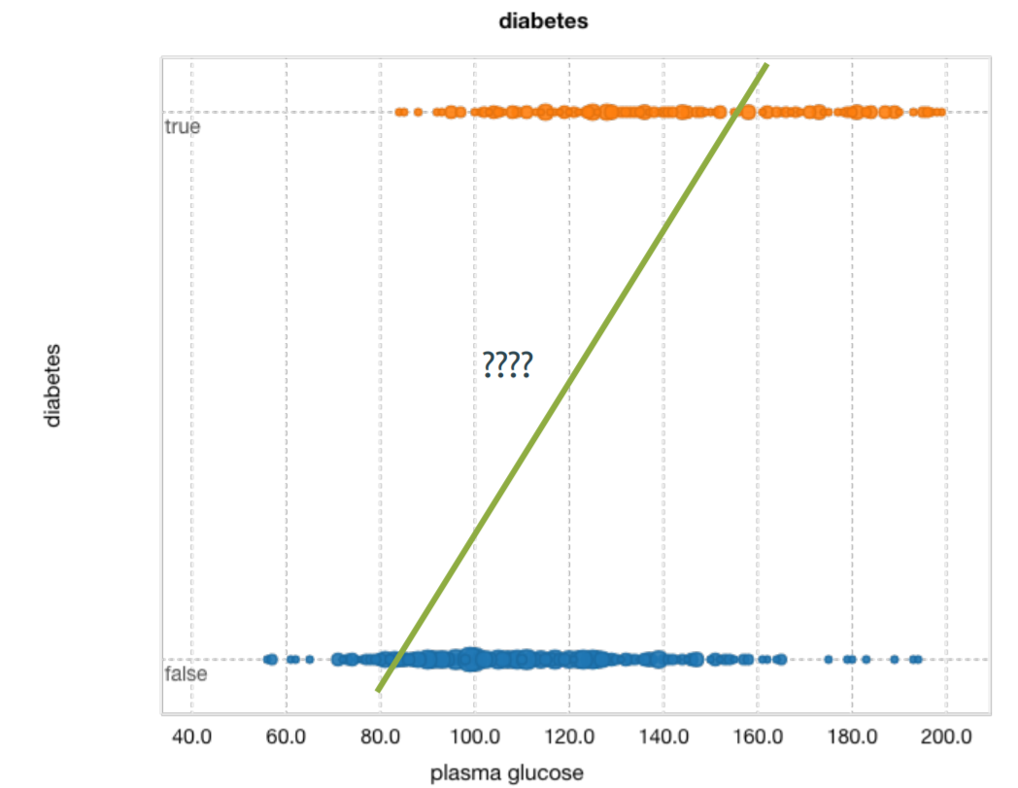

Logistic Regression – Diabetes Dataset
$$\hat{y}=mx+c$$
$$\hat{ y}=Value predicted by current Algorithm$$
Linear Regression in one Variable

Slide 7
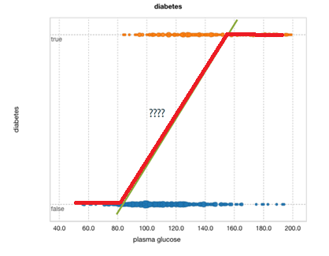


Logistic Regression – Diabetes Dataset
$$\hat{y}=mx+c$$
$$p=\frac{1}{1+e^{−\hat{y}}}$$

Slide 8
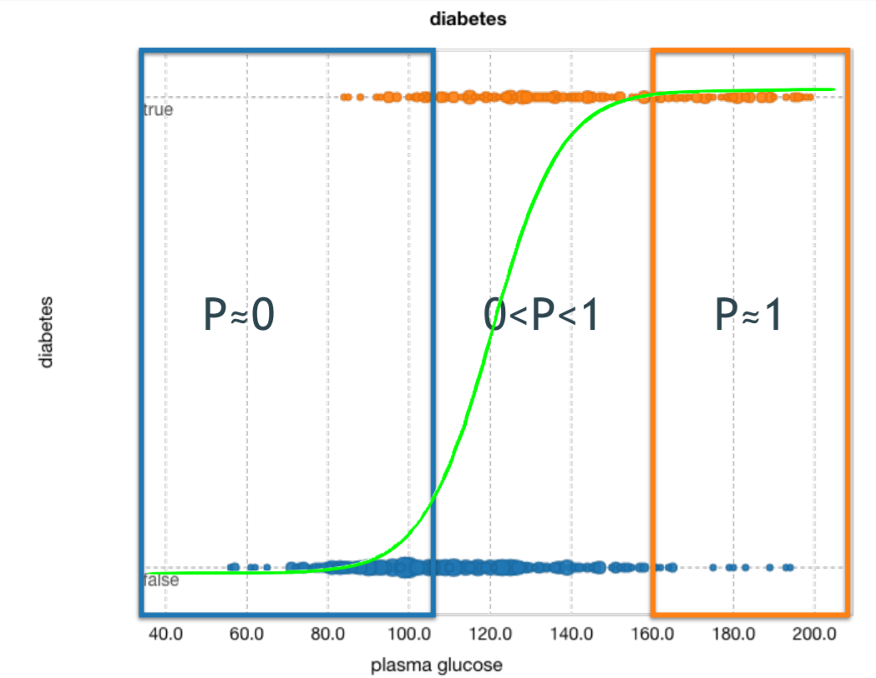


Logistic Regression – Diabetes Dataset
$$p=\frac{1}{1+e^{−\hat{y}}}$$
$$p=\frac{1}{1+e^{−(mx+c)}}$$

Slide 9


Logistic Regression – Diabetes Dataset
$$p=\frac{1}{1+e^{−(mx+c)}}$$
$$ln\left(\frac{p}{1−p}\right)=mx+c$$

Slide 10
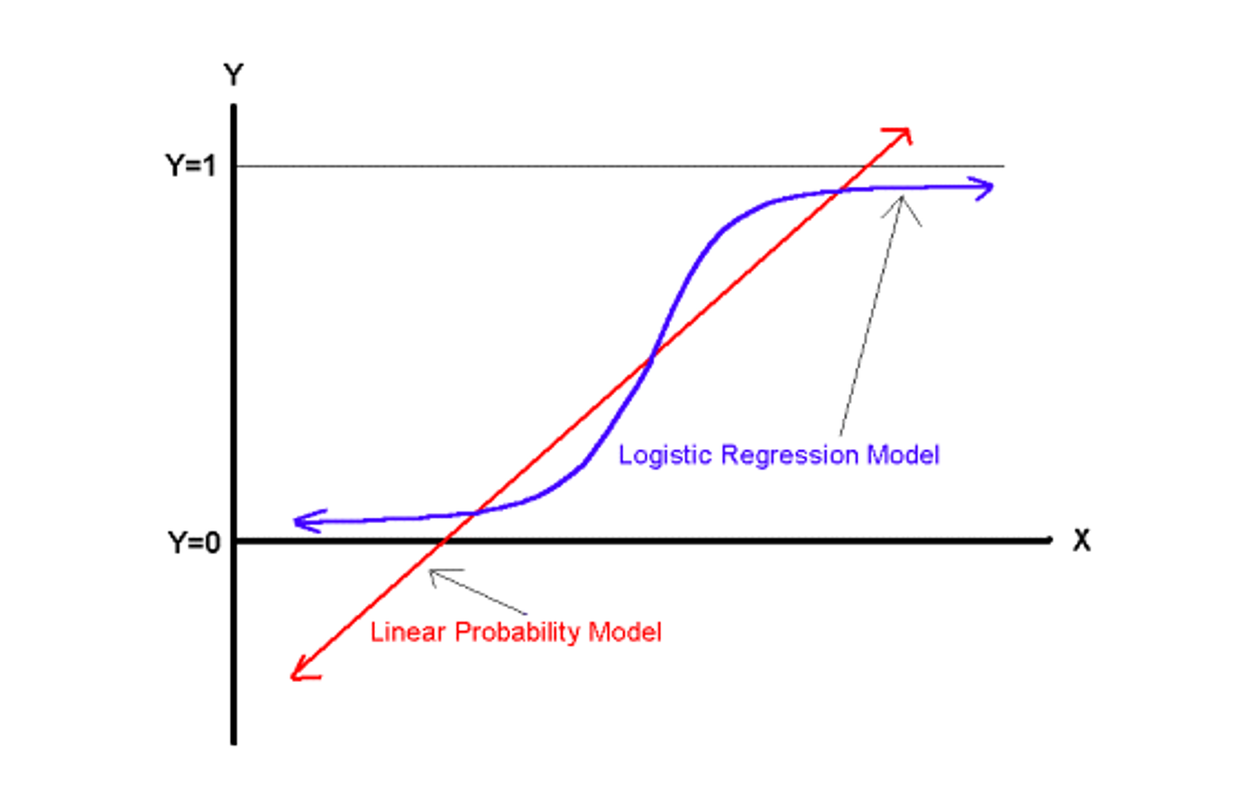
Comparing Linear Probability Model and Logistic Regression Model

Slide 11
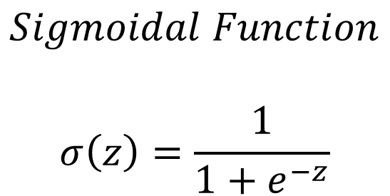
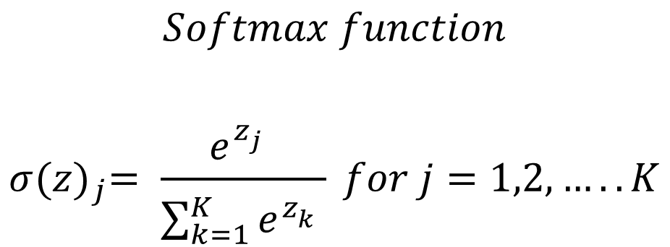
Binary Classification using Logistic Regression
Multinomial Classification using Logistic Regression
$$Sigmoidal Function$$
$$σ\left(z\right)=\frac{1}{1+e^{−z}}$$
$$Softmax function$$
$$σ{(z)}_{j}= \frac{e^{z_{j}^{}}}{\sum_{k=1}^{K}{e^{z_{k}^{}}}} for j=1,2,…..K$$

Slide 12
Maximum Likelihood Estimation (MLE)
MLE is a statistical method for estimating the coefficients of a model.
The likelihood function (L) measures the probability of observing the particular set of dependent variable values (p1, p2, ..., pn) that occur in the sample: L = Prob (p1* p2* * * pn)
The higher the L, the higher the probability of observing the ps in the sample.

Slide 13
Maximum Likelihood Estimation (MLE)
MLE involves finding the coefficients (, ) that makes the log of the likelihood function (LL < 0) as large as possible
Or, finds the coefficients that make -2 times the log of the likelihood function (-2LL) as small as possible
The maximum likelihood estimates solve the following condition: {Y - p(Y=1)}Xi = 0 summed over all observations, i = 1,…,n

Slide 14
Objective of Logistic Regression
Binary Classification:
Given the subject and the email text predicting, Email Spam or not.
Sunny or rainy day prediction, using the weather information.
Based on the bank customer history, Predicting whether to give the loan or not.
Multi-Classification:
Given the dimensional information of the object, Identifying the shape of the object.
Identifying the different kinds of vehicles.
Based on the color intensities, Predicting the color type

Slide 15

Model Evaluation
Anshu Pandey

Slide 16

Confusion Matrix
Example
True positive: Sick people correctly identified as sick
False positive: Healthy people incorrectly identified as sick
True negative: Healthy people correctly identified as healthy
False negative: Sick people incorrectly identified as healthy
True positive = correctly identified
False positive = incorrectly identified
True negative = correctly rejected
False negative = incorrectly rejected

Slide 17

Accuracy

Slide 18
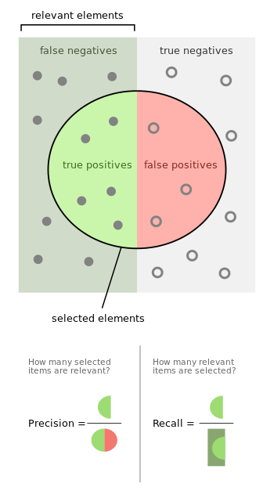
Relevancy Score 1. Precision 2. Recall

Slide 19
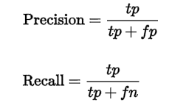
Recall
The fraction of relevant instances that have been retrieved over the total amount of relevant instances.
The recall is intuitively the ability of the classifier to find all the positive samples.

Slide 20
Precision
The fraction of relevant instances among the retrieved instances.
The precision is intuitively the ability of the classifier to not label a sample as positive if it is negative.

Slide 21

F1 Score
A measure that combines precision and recall is the harmonic mean of precision and recall.

Slide 22
Logistic Regression
Python code using sklearn

Slide 23
Bank Marketing Dataset
The dataset is taken from
http://archive.ics.uci.edu/ml/datasets/Bank+Marketing
it is related to direct marketing campaigns (phone calls) of a Portuguese banking institution. The classification goal is to predict whether the client will subscribe (1/0) to a term deposit (variable y).
The dataset provides the bank customers’ information. It includes 41,188 records and 21 fields.

Slide 24
Input variables: # bank client data: 1 - age (numeric) 2 - job : type of job (categorical: 'admin.','blue-collar','entrepreneur','housemaid','management','retired','self-employed','services','student','technician','unemployed','unknown') 3 - marital : marital status (categorical: 'divorced','married','single','unknown'; note: 'divorced' means divorced or widowed) 4 - education (categorical: 'basic.4y','basic.6y','basic.9y','high.school','illiterate','professional.course','university.degree','unknown') 5 - default: has credit in default? (categorical: 'no','yes','unknown') 6 - housing: has housing loan? (categorical: 'no','yes','unknown') 7 - loan: has personal loan? (categorical: 'no','yes','unknown') # related with the last contact of the current campaign: 8 - contact: contact communication type (categorical: 'cellular','telephone') 9 - month: last contact month of year (categorical: 'jan', 'feb', 'mar', ..., 'nov', 'dec') 10 - day_of_week: last contact day of the week (categorical: 'mon','tue','wed','thu','fri')

Slide 25
11 - duration: last contact duration, in seconds (numeric).
Important note: this attribute highly affects the output target (e.g., if duration=0 then y='no'). Yet, the duration is not known before a call is performed. Also, after the end of the call y is obviously known. Thus, this input should only be included for benchmark purposes and should be discarded if the intention is to have a realistic predictive model. 12 - campaign: number of contacts performed during this campaign and for this client (numeric, includes last contact) 13 - pdays: number of days that passed by after the client was last contacted from a previous campaign (numeric; 999 means client was not previously contacted) 14 - previous: number of contacts performed before this campaign and for this client (numeric) 15 - poutcome: outcome of the previous marketing campaign (categorical: 'failure','nonexistent','success') # social and economic context attributes 16 - emp.var.rate: employment variation rate - quarterly indicator (numeric) 17 - cons.price.idx: consumer price index - monthly indicator (numeric) 18 - cons.conf.idx: consumer confidence index - monthly indicator (numeric) 19 - euribor3m: euribor 3 month rate - daily indicator (numeric) 20 - nr.employed: number of employees - quarterly indicator (numeric)

Slide 26
Output variable (desired target): 21 - y - has the client subscribed a term deposit? (binary: 'yes','no')

Slide 27
Import the libraries
import pandas as pd
import numpy as np
from sklearn import preprocessing
import matplotlib.pyplot as plt
plt.rc("font", size=14)
from sklearn.linear_model import LogisticRegression
from sklearn.cross_validation import train_test_split
import seaborn as sns
sns.set(style="white")
sns.set(style="whitegrid", color_codes=True)

Slide 28
Import dataset
data = pd.read_csv('bank.csv', header=0)
data = data.dropna()
print(data.shape)
print(list(data.columns))

Slide 29
Barplot for dependent variable
sns.countplot(x='y',data=data, palette='hls')
plt.show()

Slide 30
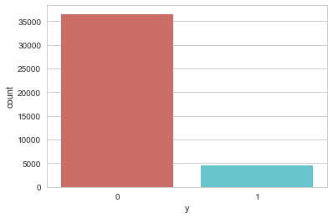
Barplot for dependent Variable

Slide 31
Customer job distribution
sns.countplot(y="job", data=data)
plt.show()

Slide 32
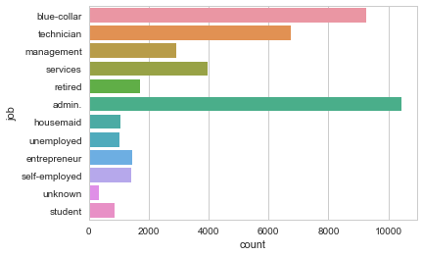
Customer job distribution

Slide 33
Customer Marital Status Distribution
sns.countplot(x="marital", data=data)
plt.show()

Slide 34
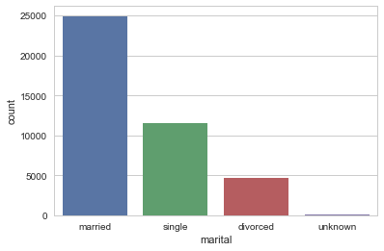
Customer Marital Status Distribution

Slide 35
Barplot for Credit in default
sns.countplot(x="default", data=data)
plt.show()

Slide 36
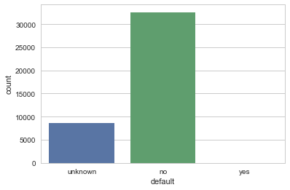
Barplot for Credit in default

Slide 37
Barplot for housing loan
sns.countplot(x="housing", data=data)
plt.show()

Slide 38
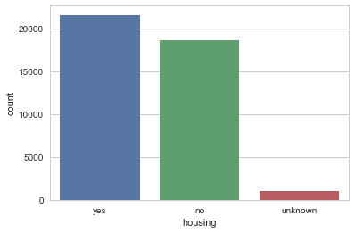
Barplot for housing loan

Slide 39
Barplot for personal loan
sns.countplot(x="loan", data=data)
plt.show()

Slide 40
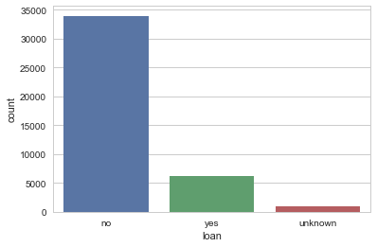
Barplot for personal loan

Slide 41
Barplot for previous marketing campaign outcome
sns.countplot(x="poutcome", data=data)
plt.show()

Slide 42
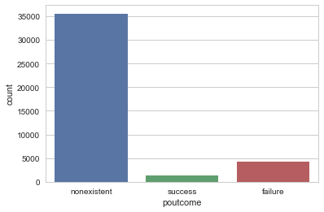
Barplot for previous marketing campaign outcome

Slide 43
Feature Selection
Our prediction will be based on the customer’s job, marital status, whether he(she) has credit in default, whether he(she) has a housing loan, whether he(she) has a personal loan, and the outcome of the previous marketing campaigns. So, we will drop the variables that we do not need.
data.drop(data.columns[[0, 3, 7, 8, 9, 10, 11, 12, 13, 15, 16, 17, 18, 19]], axis=1, inplace=True)

Slide 44
Data Preprocessing – Create dummy variables
In logistic regression models, encoding all of the independent variables as dummy variables allows easy interpretation and calculation of the odds ratios, and increases the stability and significance of the coefficients
data2 = pd.get_dummies(data, columns =['job', 'marital', 'default', 'housing', 'loan', 'poutcome'])

Slide 45
Data Preprocessing – drop unknown columns
data2.drop(data2.columns[[12, 16, 18, 21, 24]], axis=1, inplace=True)
data2.columns

Slide 46
Data Preprocessing – Check independence between independent variables
sns.heatmap(data2.corr())
plt.show()

Slide 47
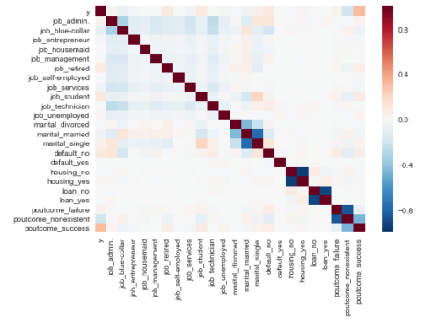
Data Preprocessing – Check independence between independent variables

Slide 48
Train test Split
X = data2.iloc[:,1:]
y = data2.iloc[:,0]
X_train, X_test, y_train, y_test = train_test_split(X, y, random_state=0)

Slide 49
Fit Logistic Regression Model
classifier = LogisticRegression(random_state=0)
classifier.fit(X_train, y_train)

Slide 50
Predicting the test set results and creating confusion matrix
y_pred = classifier.predict(X_test)
from sklearn.metrics import confusion_matrix
confusion_matrix = confusion_matrix(y_test, y_pred)
print(confusion_matrix)

Slide 51
Accuracy
print('Accuracy of logistic regression classifier on test set: {:.2f}'.format(classifier.score(X_test, y_test)))

Slide 52
Classification Report
from sklearn.metrics import classification_report
print(classification_report(y_test, y_pred))

Slide 53
Interpretation
Of the entire test set, 88% of the promoted term deposit were the term deposit that the customers liked. Of the entire test set, 90% of the customer’s preferred term deposits that were promoted.

Slide 54
Classifier visualization playground
The purpose of this section is to visualize logistic regression classsifiers’ decision boundaries. In order to better vizualize the decision boundaries, we’ll perform Principal Component Analysis (PCA) on the data to reduce the dimensionality to 2 dimensions
from sklearn.decomposition import PCA
X = data2.iloc[:,1:]
y = data2.iloc[:,0]
pca = PCA(n_components=2).fit_transform(X)
X_train, X_test, y_train, y_test = train_test_split(pca, y, random_state=0)

Slide 55
Classifier visualization playground
plt.figure(dpi=120)
plt.scatter(pca[y.values==0,0], pca[y.values==0,1], alpha=0.5, label='YES', s=2, color='navy')
plt.scatter(pca[y.values==1,0], pca[y.values==1,1], alpha=0.5, label='NO', s=2, color='darkorange')
plt.legend()
plt.title('Bank Marketing Data Set\nFirst Two Principal Components')
plt.xlabel('PC1')
plt.ylabel('PC2')
plt.gca().set_aspect('equal')
plt.show()

Slide 56
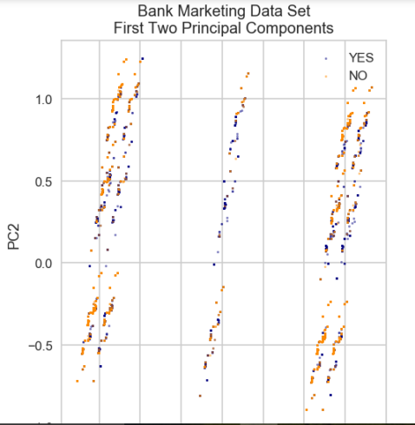
Classifier visualization playground

Slide 57
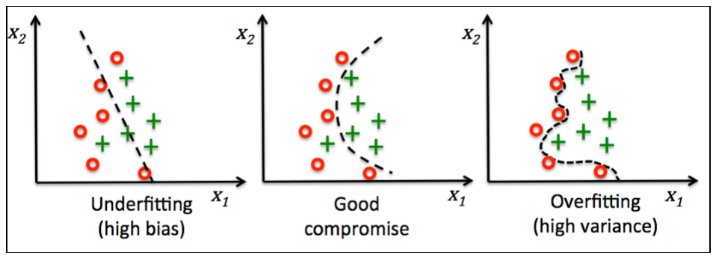
Overfitting & Generalisation

Slide 58
Regularization for logistic Regression
sklearn.linear_model.LogisticRegression(penalty=’l2’, dual=False, tol=0.0001, C=1.0, fit_intercept=True, intercept_scaling=1, class_weight=None, random_state=None, solver=’liblinear’, max_iter=100, multi_class=’ovr’, verbose=0, warm_start=False, n_jobs=1

Slide 59
Thank you
Stay tuned for practicing Logistic Regression with datasets

